Slide 2
SERIAL COMMUNICATION IN MICROCONTROLLER
A general Embedded system consists of various building blocks.
All these building blocks should communicate with each other.
They must share a common communication protocol.
Hundreds of communication protocols have been defined to achieve this data exchange.
Can be separated into one of two categories: parallel or serial.

Slide 3
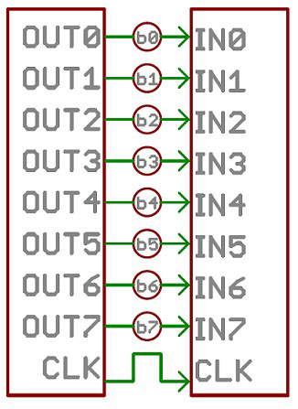
Parallel vs. Serial
Parallel interfaces transfer multiple bits at the same time.
Transmitting across eight, sixteen, or more wires

Slide 4
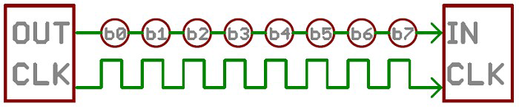
Parallel vs. Serial (Continue..)
Serial interfaces stream their data, one bit at a time.
These interfaces can operate with lesser number of wires.
Eg: USB, Ethernet, SPI, I2C, ...
synchronous or asynchronous.

Slide 5

Synchronous serial interface
A synchronous serial interface always pairs its data line(s) with a clock signal
So all devices on a synchronous serial bus share a common clock
Faster serial transfer
Requires at least one extra wire between communicating devices
Eg: SPI, I2C

Slide 6
Asynchronous serial interface
Asynchronous means that data is transferred without support from an external clock signal.
Clock-less serial protocol
Minimizing required wires and I/O pins
This is used for GPS module, Bluetooth, XBee’s, serial LCDs, or many other external devices

Slide 7
Baud Rate
The baud rate specifies how fast data is sent over a serial line
It’s usually expressed in units of bits-per second (bps)
Common 9600 bps.
Other “standard” baud are 1200, 2400, 4800, 19200, 38400, 57600, and 115200.

Slide 8


Framing the data

Slide 9
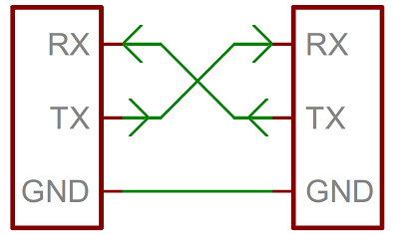
Wiring

Slide 10
Hello world !

Slide 11
Serial write functions
Serial.println();
Serial.print();
Serial.write();

Slide 12
Tasks
Program to print all natural numbers in serial monitor with 1 second delay.
Start printing natural numbers when char “a” is entered and stop printing when char “s” is entered.

Slide 13
Tasks
Read the entered character from the keyboard
If character is 'r', RED LED ON.
If character is 'b', BLUE LED ON.
If character is 'g', GREEN LED ON.
If character is 'a', all LED ON.
If character is 's', all LED OFF.
Using IF, ELSE condition
Above problem using SWICH CASE condition

Slide 14
Tasks
Read String(RGB, BGR, GRB,....) from the keyboard and Blink the LED as per input sequence with 2 second delay.
Read integer from the keyboard(4 digit delay value) and blink RED, GREEN, BLUE with entered delay.

Slide 15
Tasks
Lights four LEDs in sequence, then in reverse the order using a for() loop.
Also use “for loop” to setup the pins to output mode.

